Slide 1
CS 35L Software Construction Lab Week 9 (:O) – SSH Part I

Slide 2
Assignment 10
Please upload your report and presentation under the Lab 7 link on CCLE Week 10 page. Thanks!
Please submit Assignment 8 under Lab 7

Slide 3
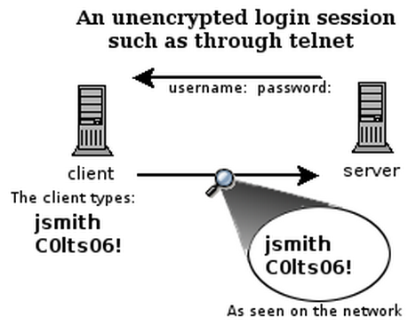
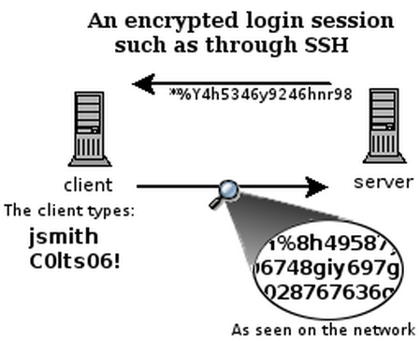
What is SSH?
Secure Shell
Used to remotely access shell
Successor of telnet
Encrypted and better authenticated session

Slide 4
Encryption Types
Symmetric Key Encryption
a.k.a shared/secret key
Key used to encrypt is the same as key used to decrypt
Asymmetric Key Encryption: Public/Private
2 different (but related) keys: public and private
Only creator knows the relation. Private key cannot be derived from public key
Data encrypted with public key can only be decrypted by private key and vice versa
Public key can be seen by anyone
Never publish private key!!!

Slide 5
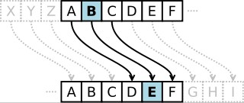
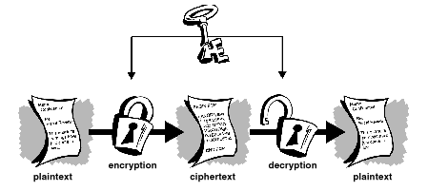
Symmetric-key Encrption
●
Same secret key used for encryption and decryption
●
Example : Data Encryption Standard (DES)
●
Caesar's cipher
–
Map the alphabet to a shifted version
●
ABCDEFGHIJKLMNOPQRSTUVWXYZ DEFGHIJKLMNOPQRSTUVWXYZABC
●
–
Plaintext – SECRET. Ciphertext – VHFUHW Key is 3 (number of shifts of the alphabet)
–
●
Key distribution is a problem
Image Source: wikipedia
–
The secret key has to be delivered in a safe way to the recipient Chance of key being compromised
–
Image Source: gpgtools.org

Slide 6
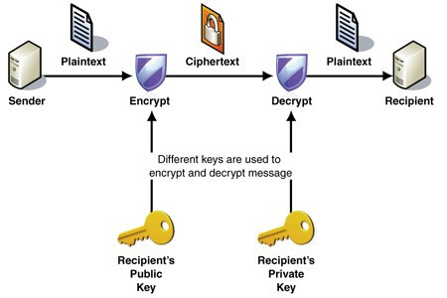
Public-key Encryption (Asymmetric)
●
Uses a pair of keys for encryption
–
Public key – Published and known to everyone
Private key – Secret key known only to the owner
–
●
Encryption
–
Use public key to encrypt messages
Anyone can encrypt message, but they cannot decrypt the ciphertext
–
●
Decryption
–
Use private key to decrypt messages
●
Example : RSA – Rivest, Shamir & Adleman
Property used - Difficulty of factoring large
integers to prime numbers
N = p * q (3233 = 61 * 53)
N is a large integer and p, q are prime numbers N is part of the public key
https://en.wikipedia.org/wiki/RSA_(cryptosystem)
Image Source: MSDN

Slide 7
High-Level SSH Protocol
Client ssh’s to remote server
$ ssh username@somehost
If first time talking to server -> host validation
The authenticity of host 'somehost (192.168.1.1)' can't be established. RSA key fingerprint is 90:9c:46:ab:03:1d:30:2c:5c:87:c5:c7:d9:13:5d:75. Are you sure you want to continue connecting (yes/no)? yes Warning: Permanently added 'somehost' (RSA) to the list of known hosts.
ssh doesn't know about this host yet
shows hostname, IP address and fingerprint of the server’s public key, so you can be sure you're talking to the correct computer
After accepting, public key is saved in ~/.ssh/known_hosts

Slide 8
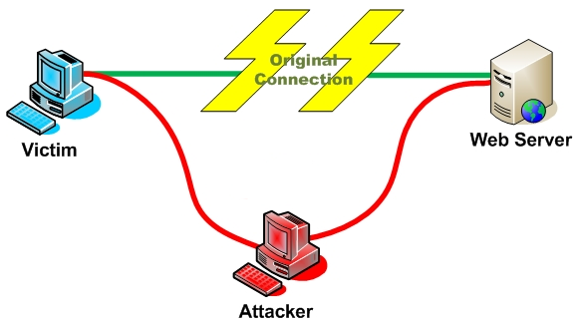
Host Validation
Next time client connects to server
Check host’s public key against saved public key
If they don’t match
$ ssh username@somehost @@@@@@@@@@@@@@@@@@@@@@@@@@@@@@@ @ WARNING: REMOTE HOST IDENTIFICATION HAS CHANGED! @ @@@@@@@@@@@@@@@@@@@@@@@@@@@@@@@ IT IS POSSIBLE THAT SOMEONE IS DOING SOMETHING NASTY! Someone could be eavesdropping on you right now (man-in-the-middle attack)! It is also possible that the RSA host key has just been changed. The fingerprint for the RSA key sent by the remote host is 90:9c:46:ab:03:1d:30:2c:5c:87:c5:c7:d9:13:5d:75. Please contact your system administrator. Add correct host key in /home/user/.ssh/known_hosts to get rid of this message. Offending key in /home/user/.ssh/known_hosts:1 Password authentication is disabled to avoid man-in-the-middle attacks. Agent forwarding is disabled to avoid man-in-the-middle attacks. X11 forwarding is disabled to avoid man-in-the-middle attacks. Permission denied (publickey,password,keyboard-interactive).

Slide 9
Host Validation (cont’d)
Client asks server to prove that it is the owner of the public key using asymmetric encryption
Encrypt a message with public key
If server is true owner, it can decrypt the message with private key
If everything works, host is successfully validated

Slide 10
Session Encryption
Client and server agree on a symmetric encryption key (session key)
All messages sent between client and server
encrypted at the sender with session key
decrypted at the receiver with session key
anybody who doesn't know the session key (hopefully, no one but client and server) doesn't know any of the contents of those messages

Slide 11
User Authentication
Password-based authentication
Prompt for password on remote server
If username specified exists and remote password for it is correct then the system lets you in
Key-based authentication
Generate a key pair on the client
Copy the public key to the server (~/.ssh/authorized_keys)
Server authenticates client if it can demonstrate that it has the private key
The private key can be protected with a passphrase
Every time you ssh to a host, you will be asked for the passphrase (inconvenient!)

Slide 12
ssh-agent
A program used with OpenSSH that provides a secure way of storing the private key
ssh-add prompts user for the passphrase once and adds it to the list maintained by ssh-agent
Once passphrase is added to ssh-agent, the user will not be prompted for it again when using SSH
OpenSSH will talk to the local ssh-agent daemon and retrieve the private key from it automatically

Slide 13
X Window System
Windowing system that forms the basis for most GUIs on UNIX
X is a network-based system. It is based upon a network protocol such that a program can run on one computer but be displayed on another (X Session Forwarding)

Slide 14
Week 9 Part II

Slide 15
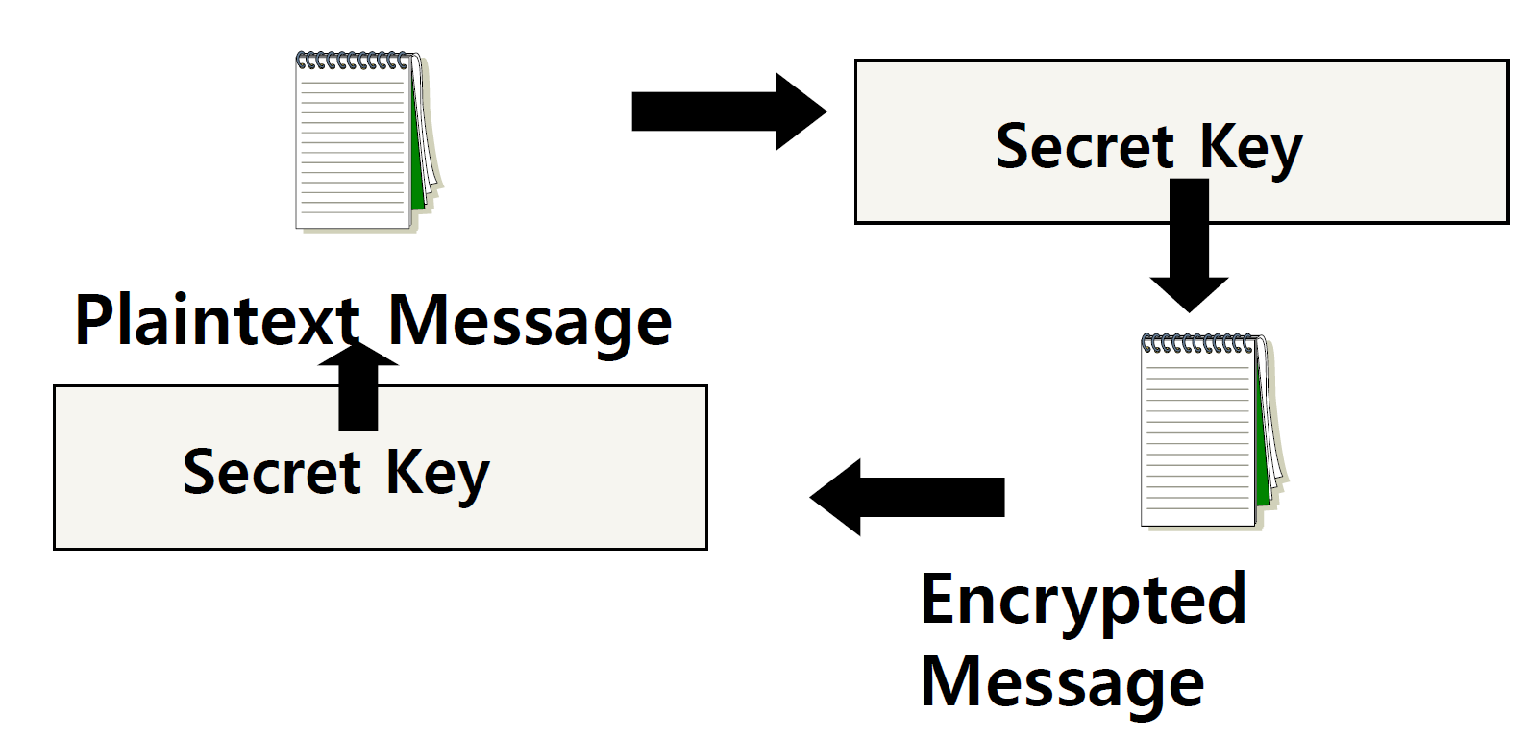
Secret Key (symmetric) Cryptography
A single key is used to both encrypt and decrypt a message

Slide 16
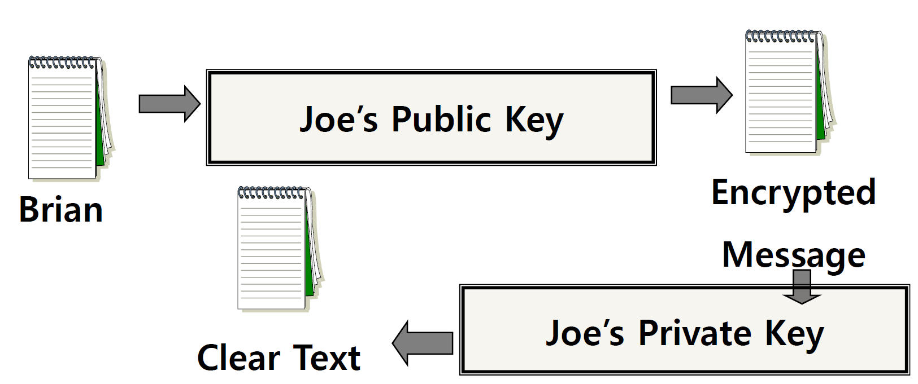
Public Key (asymmetric) Cryptography
Two keys are used: a public and a private key. If a message is encrypted with one key, it has to be decrypted with the other.

Slide 17
Digital Signature
An electronic stamp or seal
almost exactly like a written signature, except more guarantees!
Is appended to a document
Or sent separately (detached signature)
Ensures data integrity
document was not changed during transmission

Slide 18
Steps for Generating a Digital Signature
SENDER:
Generate a Message Digest
The message digest is generated using a set of hashing algorithms
A message digest is a 'summary' of the message we are going to transmit
Even the slightest change in the message produces a different digest
Create a Digital Signature
The message digest is encrypted using the sender's private key. The resulting encrypted message digest is the digital signature
Attach digital signature to message and send to receiver

Slide 19
Steps for Generating a Digital Signature
RECEIVER:
Recover the Message Digest
Decrypt the digital signature using the sender’s public key to obtain the message digest generated by the sender
Generate the Message Digest
Use the same message digest algorithm used by the sender to generate a message digest of the received message
Compare digests (the one sent by the sender as a digital signature, and the one generated by the receiver)
If they are not exactly the same => the message has been tampered with by a third party
We can be sure that the digital signature was sent by the sender (and not by a malicious user) because only the sender's public key can decrypt the digital signature and that public key is proven to be the sender’s through the certificate. If decrypting using the public key renders a faulty message digest, this means that either the message or the message digest are not exactly what the sender sent.

Slide 20
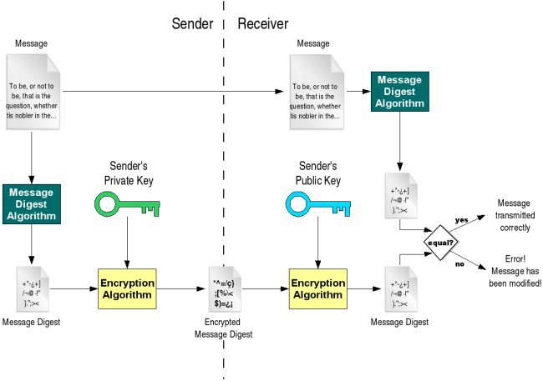
Digital Signature
Decryption Algorithm

Slide 21
Detached Signature
Digital signatures can either be attached to the message or detached.
A detached signature is stored and transmitted separately from the message it signs.
Commonly used to validate software distributed in compressed tar files.
You can't sign such a file internally without altering its contents, so the signature is created in a separate file.

Slide 22
Note
If you want to send someone a message that only they will be able to read, encrypt it with that person's public key.
If you want to publish some information and guarantee that you're the author, and that it hasn't been tampered with, then you encrypt it with your private key. That way, anyone can decrypt it with your public key and read the message. If your public key can't decrypt it, then either it wasn't encrypted with your private key, or someone who doesn't know how asymmetric keys work tried altering your work (or the data was corrupted).

Slide 23
How to Check IP Addresses
$ ifconfig
configure or display the current network interface configuration information (IP address, etc.)
$ hostname –I
gives the IP address of your machine directly
$ ping <ip_addr>(packet internet groper)
Test the reachability of a host on an IP network
measure round-trip time for messages sent from a source to a destination computer
Example: $ ping 192.168.0.1, $ ping google.com

Slide 24
Homework 8
Answer 2 questions in the file hw.txt
Generate a key pair with the GNU Privacy Guard’s commands
$ gpg --gen-key (choose default options)
Export public key, in ASCII format, into hw-pubkey.asc
$ gpg --armor --output hw-pubkey.asc --export ‘Your Name’
Make a tarball of the above files + log.txt and zip it with gzip to produce hw.tar.gz
$ tar –cf hw.tar <files>
$ gzip hw.tar -> creates hw.tar.gz
Use the private key you created to make a detached clear signature hw.tar.gz.sig for hw.tar.gz
$ gpg --armor --output hw.tar.gz.sig --detach-sign hw.tar.gz
Use given commands to verify signature and file formatting
These can be found at the end of the assignment spec

Slide 25
Lab 8
Securely log in to each others’ computers
Use ssh (OpenSSH)
Use key-based authentication
Generate key pairs
Make logins convenient
type your passphrase once and be able to use ssh to connect to any other host without typing any passwords or passphrases
Use port forwarding to run a command on a remote host that displays on your host

Slide 26
Server Steps
Generate public and private keys
$ ssh-keygen (by default saved to ~/.ssh/is_rsa and id_rsa.pub) – don’t change the default location
Create an account for the client on the server
$ sudo useradd –d /home/<homedir_name> –m <username>
$ sudo passwd <username>
Create .ssh directory for new user
$ cd /home/<homedir_name>
$ sudo mkdir .ssh
Change ownership and permission on .ssh directory
$ sudo chown –R username .ssh
$ sudo chmod 700 .ssh

Slide 27
Client Steps
Generate public and private keys
$ ssh-keygen
Copy your public key to the server for key-based authentication (~/.ssh/authorized_keys)
$ ssh-copy-id –i UserName@server_ip_addr
Add private key to authentication agent (ssh-agent)
$ ssh-add
SSH to server
$ ssh UserName@server_ip_addr
$ ssh –X UserName@server_ip_addr (X11 session forwarding)
Run a command on the remote host
$ xterm, $ gedit, $ firefox, etc.

Slide 28
Driver error on windows
http://bit.ly/2GRdnfY

